Slide 1

NATIONAL INSTITUTE OF TECHNOLOGY KARNATAKA-SURATHKAL
DEPARTMENT OF MATHEMATICAL AND COMPUTATIONAL SCIENCES
MCA-2ndSemester
(2019-2020)
Data structure and algorithms

Slide 2
PIZZA ODERING SYSTEM
Submitted By
Submitted To
Ms. DEEPTHI L
DIVAS KUMAR Roll No:-194CA019
SUSHIL KUMAR Roll No:-194CA024
ANIKET KUMAR Roll No:-194CA022
Submitted in fulfillment of the project in C language

Slide 3
ABSTRACT
The main aim of developing the census system is to allow coordination of activities from the beginning of the census process up to the end of the process.
It is meant also to facilitate the management of the population in an enhanced management and efficiency manner.
It generates a unique id for each newly added citizen so that we can fetch the information by using this unique id quickly and perform necessary action if required.
OBJECTIVE
To automatically stores and retrieves all information on the human population.
To develop a system that will support direct access to the specific and required information.
Fast process and Reduced operational time
Increased operational efficiency
Reliable system that could be used in collecting data/information on the human population.

Slide 4
Features
A user can view all the item’s in the main menu with their respective prices and select among them.
The user has to enter Quantity to proceed toward payments.
The system displays a total amount and the user has to enter amount equivalent to his/her total cost or more than that.
The system declines whenever a user provides an amount less than the total cost of the user.
After all these, the system asks whether to display payment receipt or not. If yes then, the payment receipt is displayed which includes full date, telephone, fax, order number, cashier’s name and description with total quantity, price and amount.

Slide 5
FLOWCHART
START
PRINT ”WELCOME TO PIZZA MANIA”
INPUT PIZZA_CHOICE & QUANTITY, N_C
yes
yes
N_C==Y
INPUT N_C1
yes
N_C1==1
TOTAL=QUANTIY*CHOICE
PRINT TOTAL
yes
N_C1==2
PRINT”ENTER VALID NO”
No
N_C==3
A
A

Slide 6
A
ENTER M_NO
M_NO==RECORD
No
yes
INPUT NAME,EMAIL
PRINT NAME,EMAIL
INPUT AMOUNT
AMOUNT>=TOTAL
yes
yes
PRINT INSUFFICIENT AMOUNT
PRINT SUCESSFULL
A

Slide 7
A
ENTER C_N2
C_N2==YES
yes
PRINT RECEIPT
No
PRINT “THANK FOR UR ORDER”
STOP

Slide 8
Programming Language
Pizza Ordering System is developed using C and C++ Programming Language
IN THIS PROJECT WE USE Basically #3 MODULES
Welcome() - In this module Welcoming the user.
Main Menu() - In this module all details of items are present.
Termination() - In this module say Thanks to user who uses this.

Slide 9
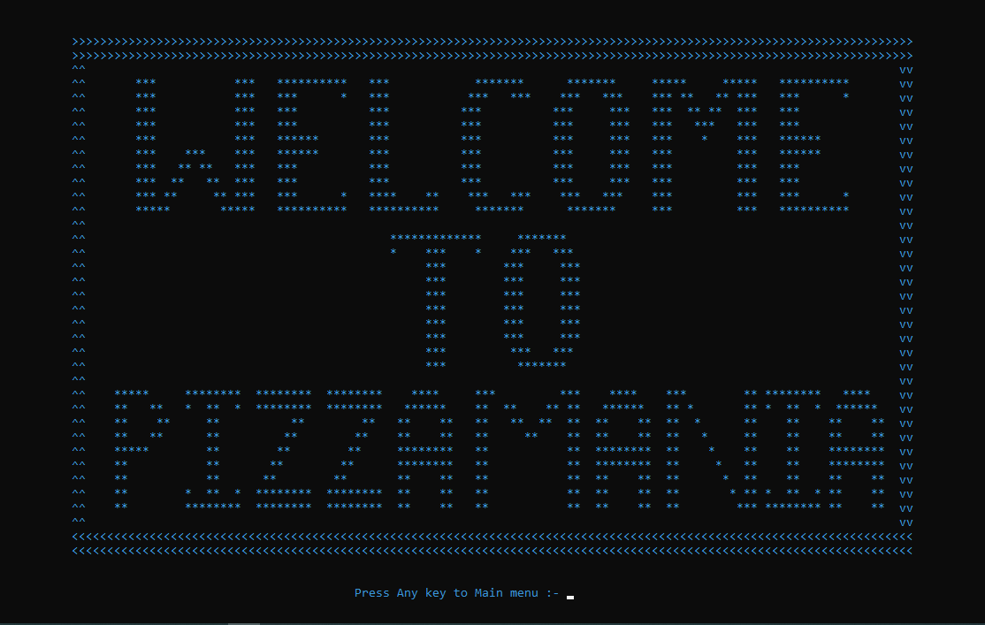
Welcome Page

Slide 10
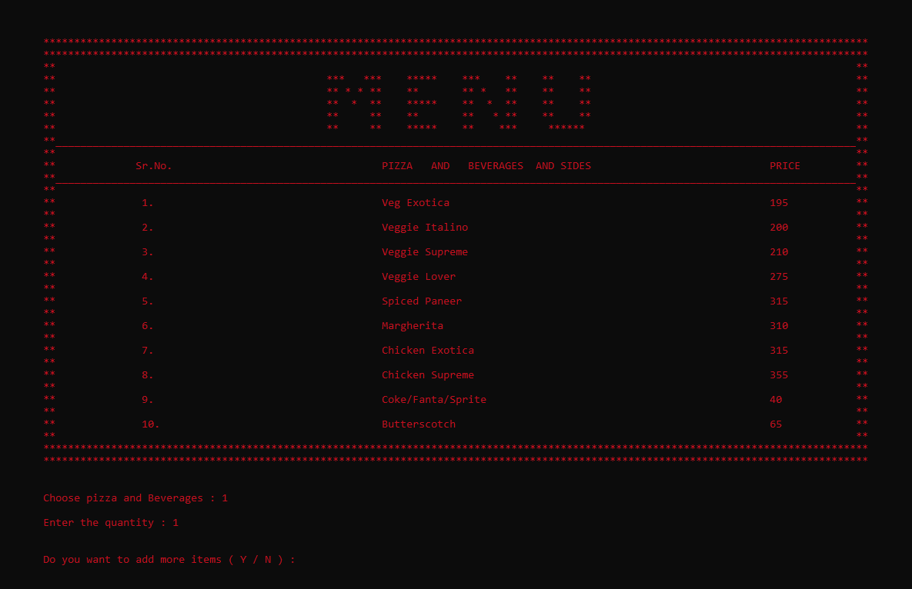
Menu Page

Slide 11
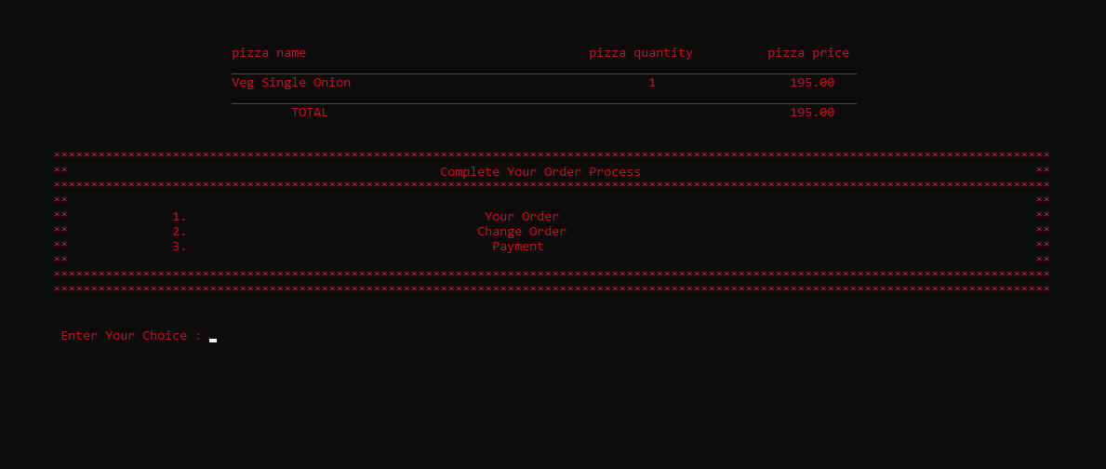
Transaction Page

Slide 12
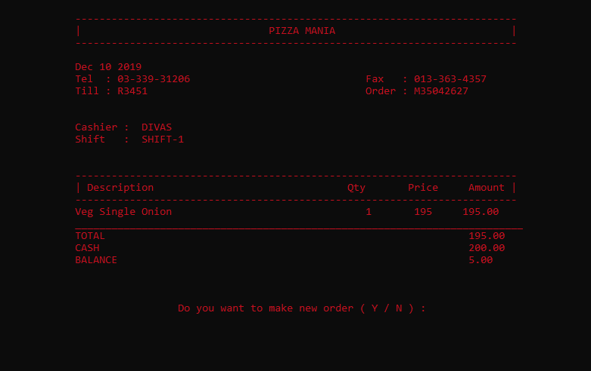
Payment receipt

Slide 13
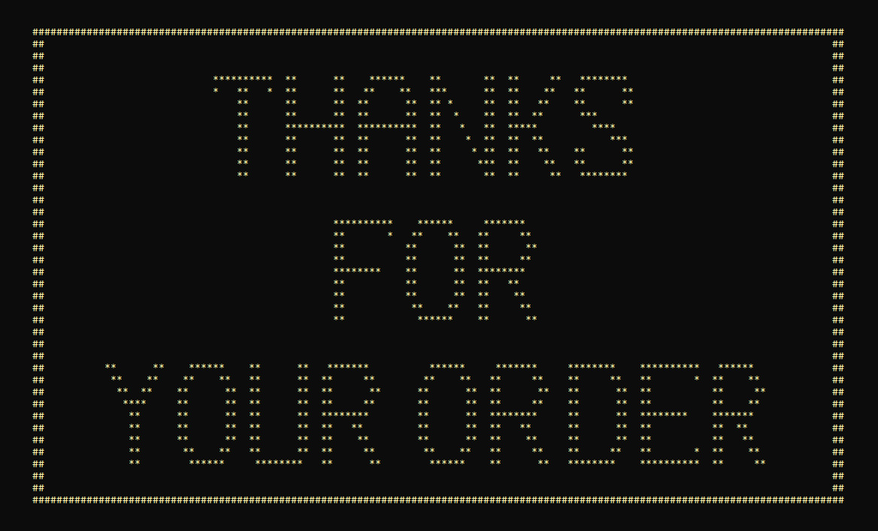
Thank You Page

Slide 14
…Thank you …

